Slide 1

Identifying high-risk rejection orders to improve customer service satisfaction
Notes:
it doesn’t include a business goal, and the context is very vague (guest count where? for what? mention CompanyX!).
Improving CompanyX successful orders by predicting transaction rejection
Implementing Instant-Book and Improving Customer Service Satisfaction

Slide 2


Business Problem
Problem statement
Stakeholder
Opport. / Challenge
Problem: high rejection rate (15%) → lost sales and customer dissatisfaction
Strategy: Provide a tool for CompanyX! to identify high-risk rejection orders.
Goal: Rank transactions with high rejection prob. of rate.
CompanyX Management Team
CompanyX Customer Service Team
Guest / Host
Competitors: Airbnb, booking.com, Agoda
Increase revenues by less rejections and faster intervention
Company will employ service team more efficiently.
Manage CompanyX! resources more efficiently.
Higher customer satisfaction
Notes:
Business problem (stakeholder, challenge/opportunity, potential benefits to stakeholder, social/human/environmental implications)

Slide 3
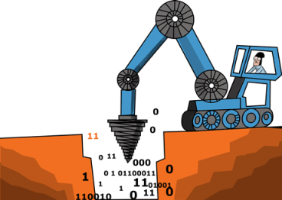
Data Mining Goal
Data Mining Goal
Outcome Variable
Methods
Ranking the probability of a transaction being rejected by the host. (supervised goal) Low risk: Normal intervention High risk: Direct intervention from Service team
Binary for Rejection (cut-off value = 0.5)
Classification
Logistics Regression
KNN
Naive Bayes
Discriminant Analysis
SVM
Classification Tree
Boosted Trees
Random Forest
Unbalanced data
Over-sampling

Slide 4

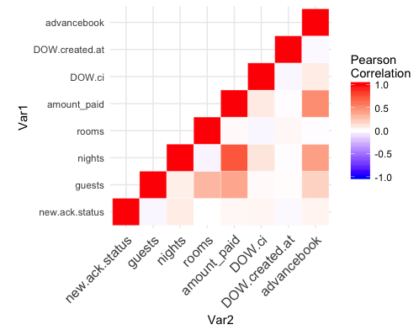
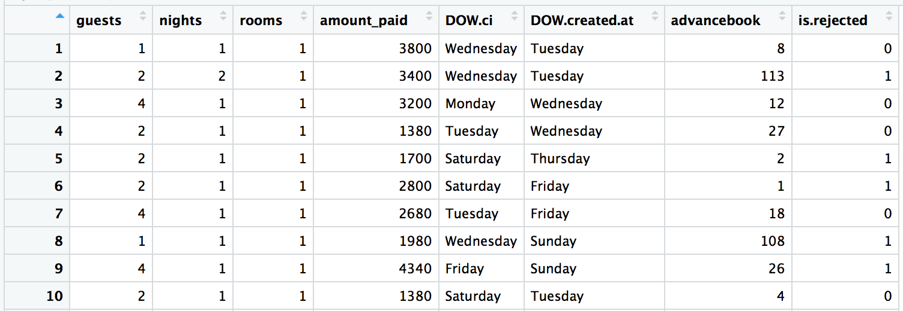
Data
Data source and size: CompanyX!, 59265 observations
Unit of Analysis: One booking transaction
Output: is.rejected [derived from new.ack.status]
Input variables:
Numeric: guests, nights, rooms, amount_paid, advancebook
Factor: DOW.ci, DOW.created.at
Data partitions:
Training (40%), Validation (30%), Test (30%)
Notes:
Data description (data source and size; data sample of 10 rows, 10 columns; what is a row of interest? Output and input variables - you can show a relevant initial chart)
Unit of analysis: One booking transaction Output: new.ack.status Input variables: - you can show a relevant initial chart)
Unit of analysis: One booking transaction
Output: new.ack.status
Input variables:
- you can show a relevant initial chart)

Slide 5


Methods & Performance Evaluation
Task: Ranking (supervised)
Benchmark: naive (the most popular class)
Relevant performance measures:
Sensitivity
Lift Chart
False Positive (Important -> lost sales / increased effort of team)
False Negative (host dissatisfaction, inactive host)
Notes:
5. Methods (supervised/unsupervised, benchmark, classification/prediction/ranking, relevant performance measures, relevance to business problem)
Relevance to business problem
Sales
Customer satisfaction

Slide 6

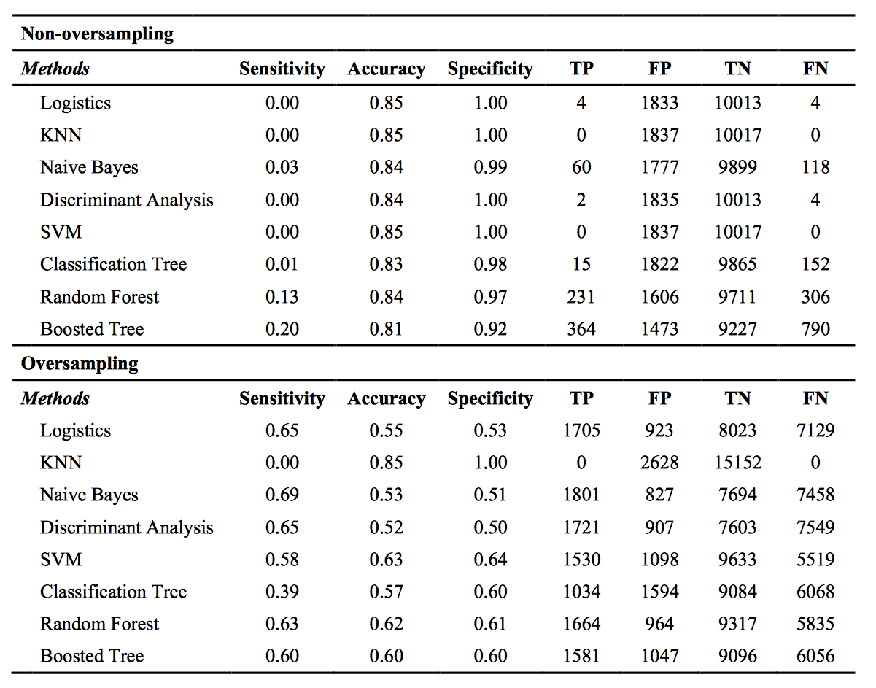
Empirical Results (Descriptive data)
 | # Records | % is.rejected
Method: Non-oversampling
Training (40%) | 29,632 | 15.13%
Validation (30%) | 17,779 | 14.69%
Testing (30%) | 11.854 | 15.50%
Method: Oversampling
Training (40%) | 7,182 | 50%
Validation (30%) | 17,779 | 15.25%
Testing (30%) | 17,780 | 14.78%
Notes:
5. Methods (supervised/unsupervised, benchmark, classification/prediction/ranking, relevant performance measures, relevance to business problem)

Slide 7
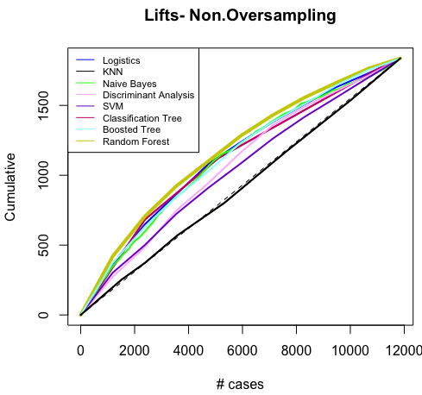
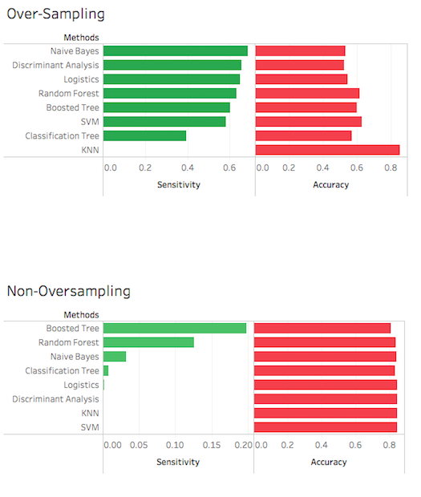
Empirical Results (Non-oversampling)
In non-oversampling, the performance of overall accuracy are similar (around 80%).
Boosted tree and random forest are top two methods in sensitivity.
Notes:
5. Methods (supervised/unsupervised, benchmark, classification/prediction/ranking, relevant performance measures, relevance to business problem)

Slide 8
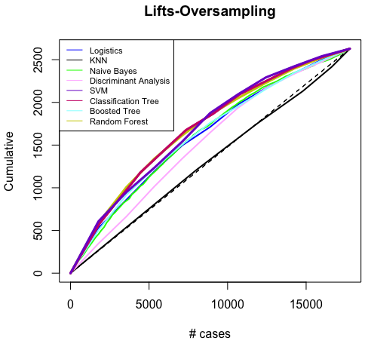
Empirical Results (Oversampling)
In oversampling, KNN gets the highest accuracy but lowest sensitivity.
Naive Bayes and discriminant analysis get better performance in in sensitivity.
Notes:
5. Methods (supervised/unsupervised, benchmark, classification/prediction/ranking, relevant performance measures, relevance to business problem)

Slide 9

Recommendation
This project identifies transactions with higher probability to be rejected using data mining algorithms to reduce dissatisfaction and increase profits.
Due to the unbalanced dataset and ranking goal, we suggest to adopt oversampling with Naive Bayes method to build the predictive model.
Although we can make the prediction based on the current datasets (accuracy = 0.69), more derived variables could be collected and included in predictive model for performance improvement.
dynamic popularity: popularity of the properties at specific time
property location: location of the properties
host’s commitment: the degree of how hosts’ commitment to the platform
Seasonal popularity: whether its a national/international holidays
Notes:
This project identifies transactions with higher probability to be rejected to reduce dissatisfaction and increase profits using data mining algorithms.
Due to the unbalanced dataset and ranking goal, we suggest to adopt oversampling with Naive Bayes method to build the predictive model.
Although we can make the prediction based on the current datasets, more derived variables (such as dynamic popularity, property location, and host’s commitment) could be collected and included for performance improvement.
6. Implementation and Production considerations (who exactly will use the system and how? real-time deployment? one-time analysis or ongoing?)
6. Implementation and Production considerations (who exactly will use the system and how? real-time deployment? one-time analysis or ongoing?)

